Slide 1
Regulation of blood pH, role of buffers, concept of acidosis and alkalosis
Dr. Sajib Sarkar
Senior Resident

Slide 2
Objectives
What is pH?- Definition
Why is it necessary to maintain blood pH in narrow range?- Function
How is it regulated?- Physiology
What happens if regulation fails?- Diseases

Slide 3
Introduction
pH = - log [H⁺]
H⁺ is really a proton
Range is from 0 – 14
Acids are H⁺ donors.
Bases are H⁺ acceptors, or give up OH⁻ in solution.
Strong & weak.
HCl H⁺ + Cl⁻
H₂CO₃ H⁺ + HCO₃⁻

Slide 4
The Body and pH
Homeostasis of pH is tightly controlled
Extracellular fluid = 7.4
Blood = 7.35 – 7.45
< 6.8 or > 8.0 death occurs
Acidosis (acidemia) below 7.35
Alkalosis (alkalemia) above 7.45

Slide 5
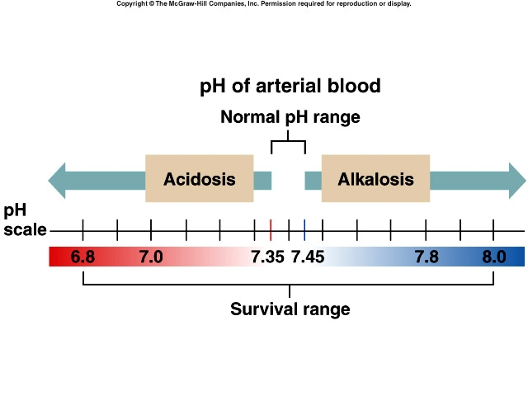

Slide 6
Why is it necessary to maintain blood pH in narrow range
Most enzymes function only with narrow pH ranges
Acid-base balance can also affect electrolytes (Na⁺, K⁺, Cl⁻)
Can also affect hormones

Slide 7
Why Blood pH Tends to Change?
Foods
Acids produced by metabolism
Cellular metabolism produces CO₂.
CO₂ + H₂0 ↔ H₂CO₃ ↔ H⁺ + HCO₃⁻
Pathological conditions- increase organic acid production

Slide 8
How is it regulated? 1. Buffers 2. Lung 3. Kidney

Slide 9
1. Buffer systems
General considerations:
Resist change of pH
Usually 1 weak acid and salt of its conjugate base
eg. Acetate buffer
pK of a buffer
Buffer capacity

Slide 10
1a. Bicarbonate buffer
Sodium Bicarbonate (NaHCO₃) and carbonic acid (H₂CO₃)
Maintain a 20:1 ratio : HCO₃⁻ : H₂CO₃
H₂CO₃ ↔ H⁺ + HCO₃⁻
HCl + NaHCO₃ ↔ H₂CO₃ + NaCl
NaOH + H₂CO₃ ↔ NaHCO₃ + H₂O

Slide 11
1b. Phosphate buffer
Major intracellular buffer
H⁺ + HPO₄²⁻ ↔ H₂PO4⁻
OH⁻ + H₂PO₄⁻ ↔ H₂O + H₂PO₄²⁻

Slide 12
1c. Protein Buffers
Includes hemoglobin, work in blood and ISF
Carboxyl group gives up H⁺
Amino Group accepts H⁺
Side chains buffer H⁺

Slide 13
2. Respiratory mechanisms
Exhalation of carbon dioxide
Powerful, but only works with volatile acids
Doesn’t affect fixed acids like lactic acid
CO₂ + H₂0 ↔ H₂CO₃ ↔ H⁺ + HCO₃⁻
Body pH can be adjusted by changing rate and depth of breathing

Slide 14
3. Role of Kidney
Conserves bicarb ions
Can eliminate large amounts of acid
Can also excrete base
Most effective regulator of pH

Slide 15
Rates of correction
Buffers function almost instantaneously
Respiratory mechanisms take minutes to hours
Renal mechanisms may take several hours to days

Slide 16
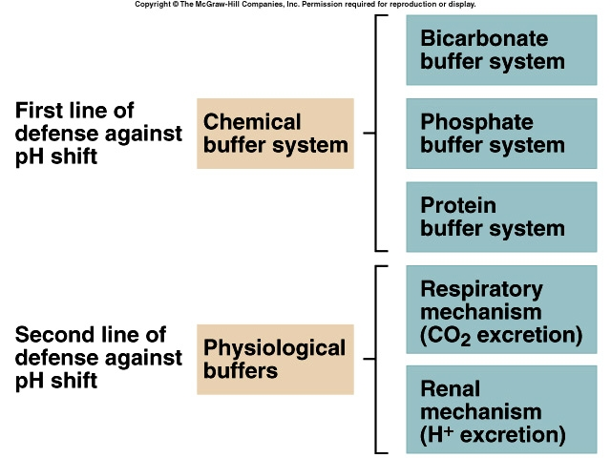

Slide 17
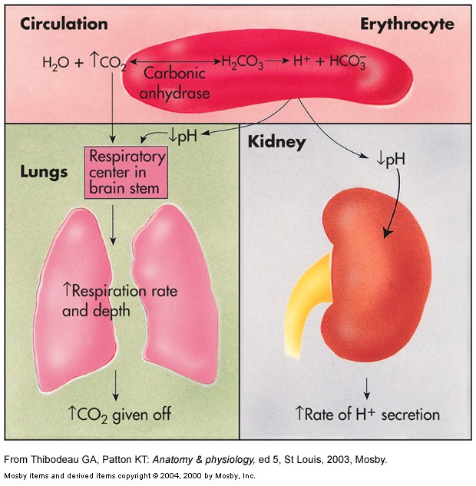

Slide 18
What should be the pH of Blood?

Slide 19
Acid-Base Imbalances
pH< 7.35 acidosis
pH > 7.45 alkalosis
The body response to acid-base imbalance is called compensation
May be complete if brought back within normal limits
Partial compensation if range is still outside norms.

Slide 20
Compensation
If underlying problem is metabolic, hyperventilation or hypoventilation can help : respiratory compensation.
If problem is respiratory, renal mechanisms can bring about metabolic compensation.

Slide 21
Acidosis
Principal effect of acidosis is depression of the CNS through ↓ in synaptic transmission.
Generalized weakness
Deranged CNS function the greatest threat
Severe acidosis causes
Disorientation
Coma
eath

Slide 22
Alkalosis
Alkalosis causes over excitability of the central and peripheral nervous systems.
Numbness
Lightheadedness
It can cause :
Nervousness
muscle spasms or tetany
Convulsions
Loss of consciousness
Death

Slide 23
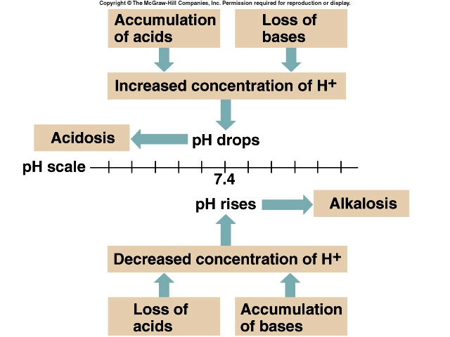

Slide 24
Respiratory Acidosis
Carbonic acid excess caused by blood levels of CO₂ above 45 mm Hg.
Hypercapnia – high levels of CO₂ in blood
Chronic conditions:
Depression of respiratory center in brain that controls breathing rate – drugs or head trauma
Paralysis of respiratory or chest muscles
Emphysema

Slide 25
Respiratory Acidosis
Acute conditons:
Adult Respiratory Distress Syndrome
Pulmonary edema
Pneumothorax

Slide 26
Compensation for Respiratory Acidosis
Kidneys eliminate hydrogen ion and retain bicarbonate ion

Slide 27
Signs and Symptoms of Respiratory Acidosis
Breathlessness
Restlessness
Lethargy and disorientation
Tremors, convulsions, coma
Respiratory rate rapid, then gradually depressed
Skin warm and flushed due to vasodilation caused by excess CO₂

Slide 28
Treatment of Respiratory Acidosis
Restore ventilation
IV lactate solution
Treat underlying dysfunction or disease

Slide 29
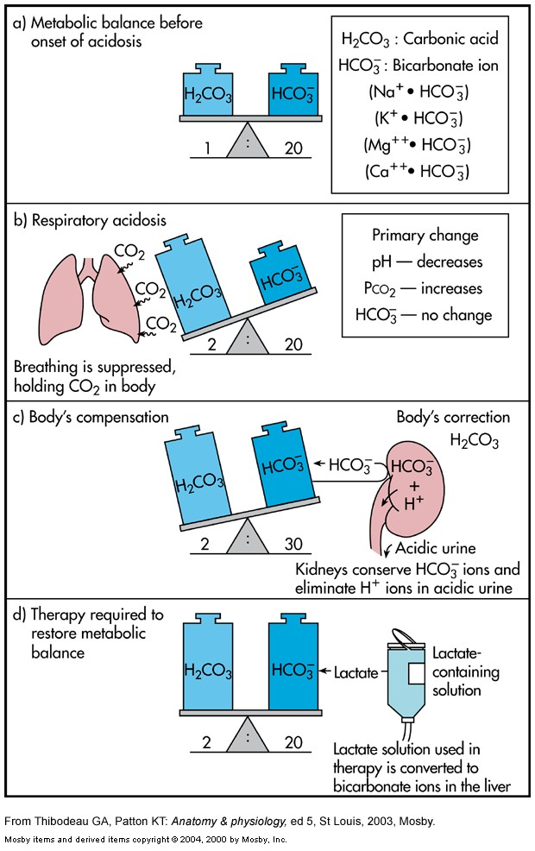

Slide 30
Respiratory Alkalosis
Carbonic acid deficit
pCO₂ less than 35 mm Hg (hypocapnea)
Most common acid-base imbalance
Primary cause is hyperventilation

Slide 31
Respiratory Alkalosis
Conditions that stimulate respiratory center:
Oxygen deficiency at high altitudes
Pulmonary disease and Congestive heart failure – caused by hypoxia
Acute anxiety
Fever, anemia
Early salicylate intoxication

Slide 32
Compensation of Respiratory Alkalosis
Kidneys conserve hydrogen ion
Excrete bicarbonate ion

Slide 33
Treatment of Respiratory Alkalosis
Treat underlying cause
Breathe into a paper bag
IV Chloride containing solution – Cl⁻ ions replace lost bicarbonate ions

Slide 34
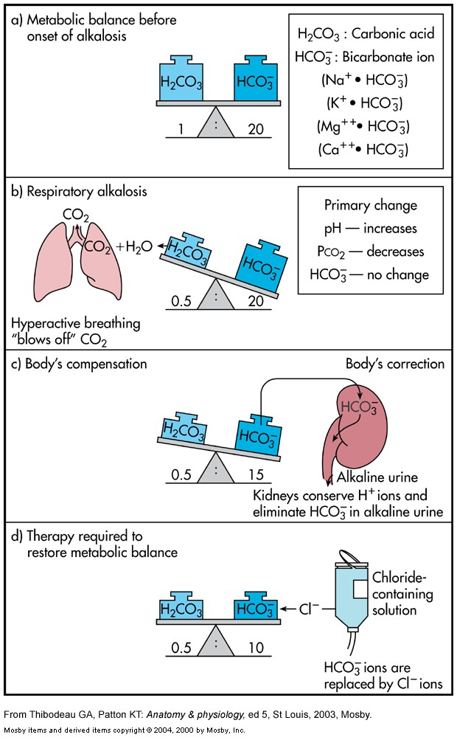

Slide 35
Metabolic Acidosis
Bicarbonate deficit - blood concentrations of bicarb drop below 22mEq/L
Causes:
Loss of bicarbonate through diarrhea or renal dysfunction
Accumulation of acids (lactic acid or ketones)
Failure of kidneys to excrete H+

Slide 36
Symptoms of Metabolic Acidosis
Headache, lethargy
Nausea, vomiting, diarrhea
Coma
Death

Slide 37
Compensation for Metabolic Acidosis
Increased ventilation
Renal excretion of hydrogen ions if possible
K⁺ exchanges with excess H⁺ in ECF
( H⁺ into cells, K⁺ out of cells)

Slide 38
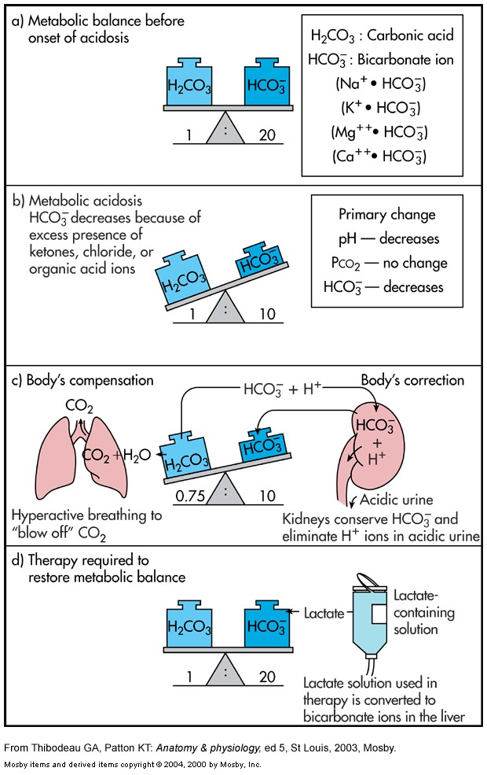

Slide 39
Metabolic Alkalosis
Bicarbonate excess - concentration in blood is greater than 26 mEq/L
Causes:
Excess vomiting = loss of stomach acid
Excessive use of alkaline drugs
Certain diuretics
Endocrine disorders
Heavy ingestion of antacids
Severe dehydration

Slide 40
Compensation for Metabolic Alkalosis
Alkalosis most commonly occurs with renal dysfunction, so can’t count on kidneys
Respiratory compensation difficult – hypoventilation limited by hypoxia

Slide 41
Symptoms of Metabolic Alkalosis
Respiration slow and shallow
Hyperactive reflexes ; tetany
Often related to depletion of electrolytes
Atrial tachycardia
Dysrhythmias

Slide 42
Treatment of Metabolic Alkalosis
Electrolytes to replace those lost
IV chloride containing solution
Treat underlying disorder

Slide 43
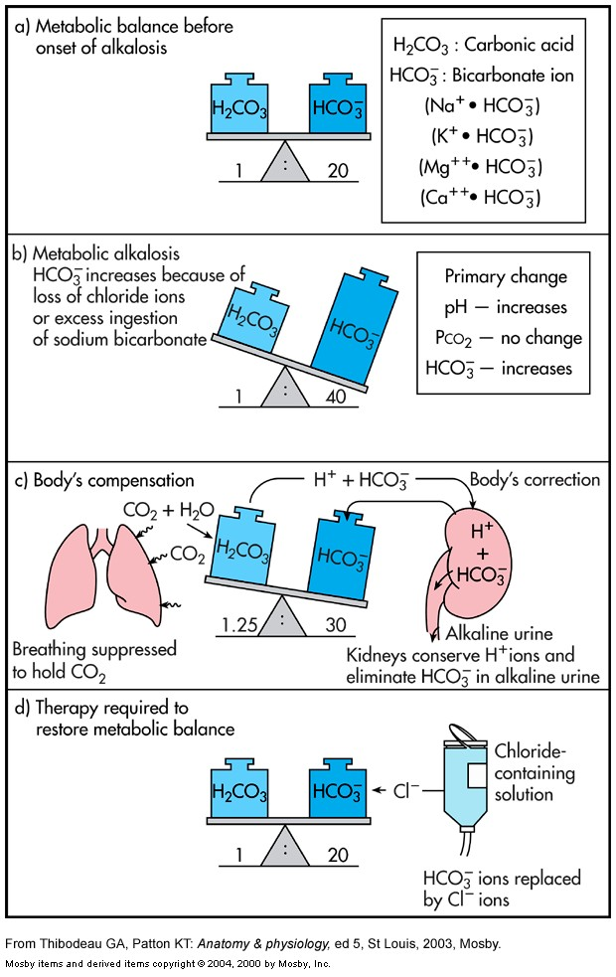

Slide 44
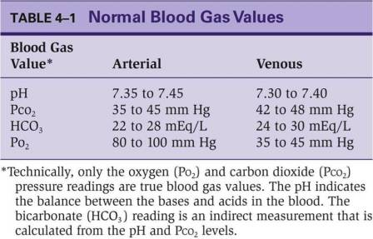
Diagnosis of Acid-Base Imbalances
What is the primary disorder?
Compensatory mechanism?
Complete or incomplete?
Investigation- ABG
Essential parameters in an ABG-
pH
HCO₃⁻
Pco₂
Po₂

Slide 45
Diagnosis of Acid-Base Imbalances
Note whether the pH is low (acidosis) or high (alkalosis) or normal (normal/ compensated).
Identify individual changes in pCO₂ or HCO₃⁻
Change correspond to the pH finding would be primary pathology.
Change in other one refers to compensation.

Slide 46
Example
A patient is in intensive care because he suffered a severe myocardial infarction 3 days ago. The lab reports the following values from an arterial blood sample:
pH 7.3 → Acidosis
HCO₃⁻ = 20 mEq / L → Met Acidosis
PCO₂ = 32 mm Hg → Resp Alkalosis
Metabolic Acidosis with
compensatory Respiratory Alkalosis

Slide 47
ABG no. | pH | PCO₂ | HCO₃⁻ | Primary | Compensatory
1 | 7.28 | 36 | 20 | Met Acidosis | Nil
2 | 7.3 | 32 | 20 | Met Acidosis | Resp Alkalosis (Incomplete)
3 | 7.36 | 30 | 20 | Met Acidosis | Resp Alkalosis (Complete)

Slide 48
Diagnose
pH =7.5
HCO₃⁻ = 31 mEq / L ( 22 - 26)
PCO₂ = 49 mm Hg (35 - 45)

Slide 49
Diagnose
pH =7.37
HCO₃⁻ = 36 mEq / L ( 22 - 26)
PCO₂ = 62 mm Hg (35 - 45)
PO₂ = 65 mm Hg (80-100)

Slide 50
THANK YOU

